Slide 1
Mathematics
Session 10: System of Equations
Haarlem
Peter Stikker
Notes:
Slides created by P. Stikker.
Version: 16 July 2019

Slide 2
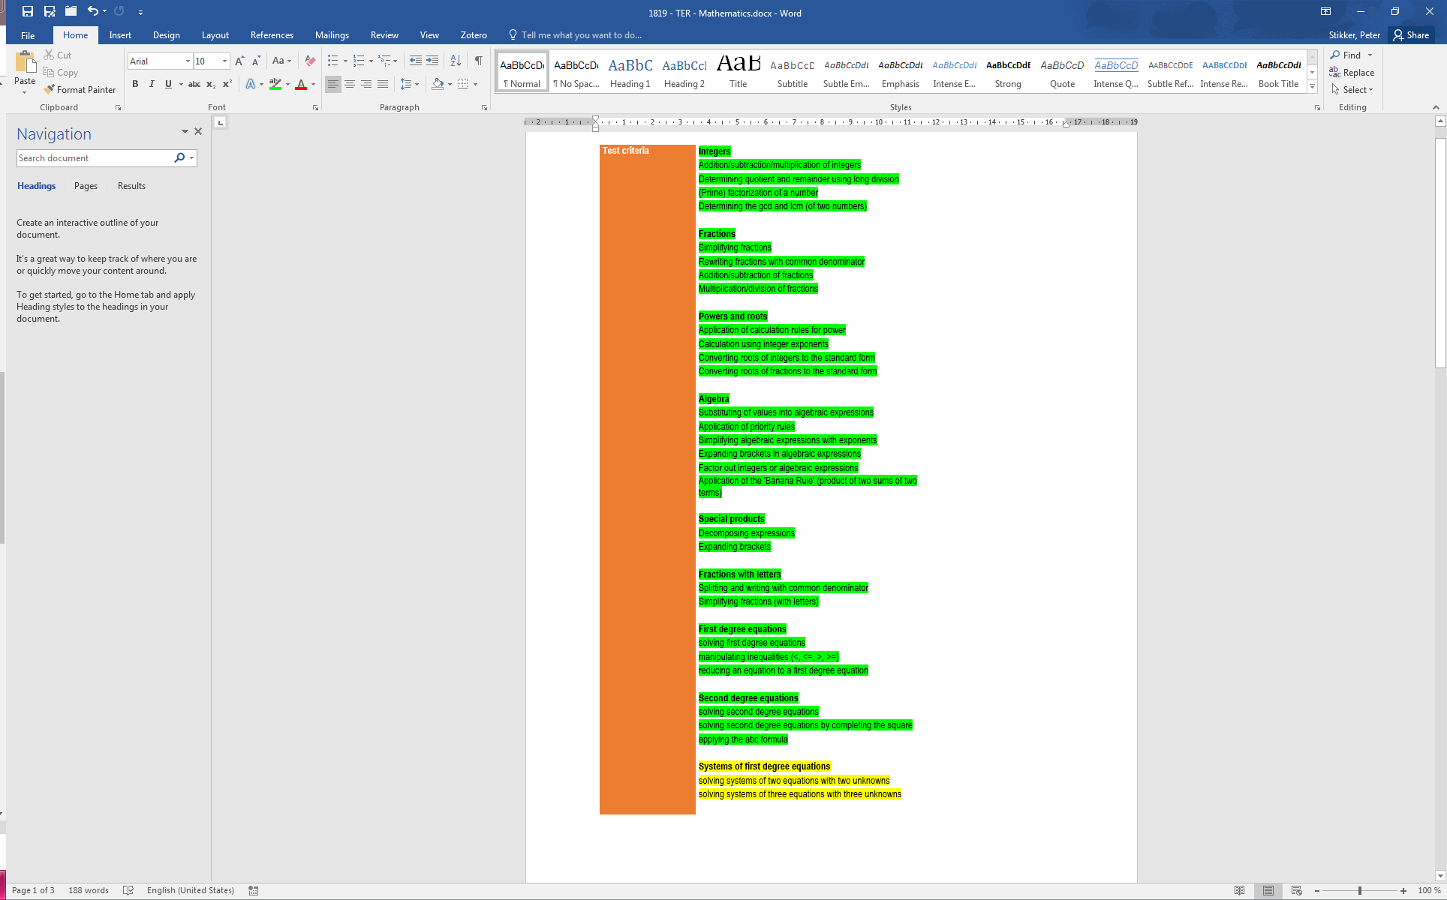
Today
System of two equations
System of three equations

Slide 3
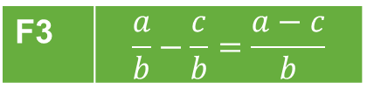
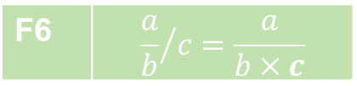


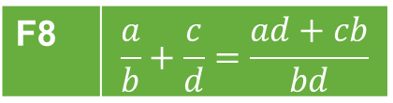

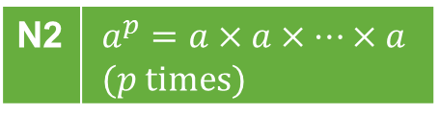

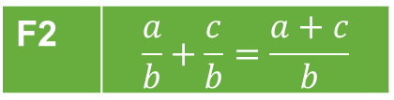
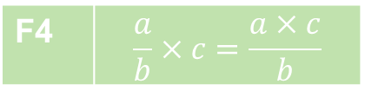

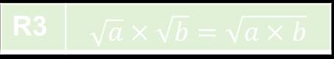

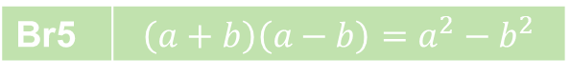







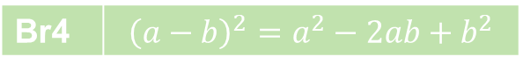

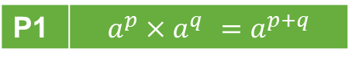

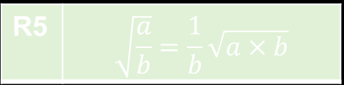
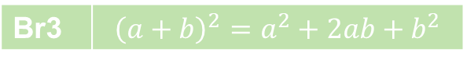


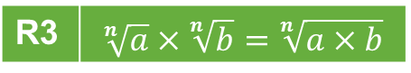
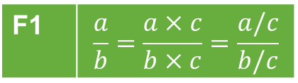
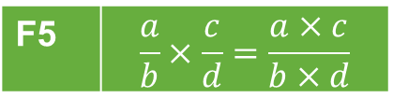
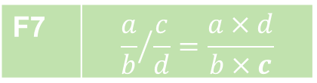

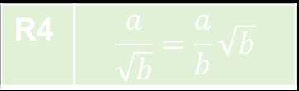

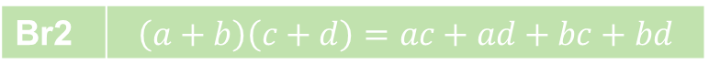
Properties
Power rules
Fraction rules
Notation rules
P1 | $$a^{p}×a^{q} =a^{p+q}$$
F1 | $$\frac{a}{b}=\frac{a×c}{b×c}=\frac{a/c}{b/c}$$
F5 | $$\frac{a}{b}×\frac{c}{d}=\frac{a×c}{b×d}$$
N1 | $$\frac{a}{b}=a/b=a:b$$
P2 | $$a^{p}:a^{q}=a^{p−q}$$
F2 | $$\frac{a}{b}+\frac{c}{b}=\frac{a+c}{b}$$
F6 | $${\frac{a}{b}}/c=\frac{a}{b×c}$$
N2 | $$a^{p}=a×a×…×a \\ (p \text{times})$$
P3 | $${\left(a^{p}\right)}^{q} =a^{p×q}$$
P4 | $${\left(a×b\right)}^{p}=a^{p}×b^{p}$$
F3 | $$\frac{a}{b}−\frac{c}{b}=\frac{a−c}{b}$$
F7 | $${\frac{a}{b}}/{\frac{c}{d}}=\frac{a×d}{b×c}$$
N3 | $$a^{1}=a$$
P5 | $${\left(\frac{a}{b}\right)}^{p}=\frac{a^{p}}{b^{p}}$$
N4 | $$a×b=a∙b=ab$$
F4 | $$\frac{a}{b}×c=\frac{a×c}{b}$$
F8 | $$\frac{a}{b}+\frac{c}{d}=\frac{ad+cb}{bd}$$
N5 | $$\sqrt{a}=\sqrt[2]{a}$$
P6 | $$a^{−p}=\frac{1}{a^{p}}$$
Basic rules
Root rules
Brackets rules
B1 | $$\frac{a}{1}=a$$
R1 | $$\sqrt{a^{2}}=a$$
R1 | $$\sqrt[n]{a^{n}}=a$$
Br1 | $$a\left(b+c\right)=ab+ac$$
R2 | $${\left(\sqrt[n]{a}\right)}^{n}=a$$
B2 | $$\frac{a}{a}=1$$
R2 | $${\left(\sqrt{a}\right)}^{2}=a$$
Br2 | $$\left(a+b\right)\left(c+d\right)=ac+ad+bc+bd$$
R3 | $$\sqrt[n]{a}×\sqrt[n]{b}=\sqrt[n]{a×b}$$
R3 | $$\sqrt{a}×\sqrt{b}=\sqrt{a×b}$$
Br3 | $${\left(a+b\right)}^{2}=a^{2}+2ab+b^{2}$$
B3 | $$a×1=a$$
R4 | $$\frac{a}{\sqrt{b}}=\frac{a}{b}\sqrt{b}$$
Br4 | $${\left(a−b\right)}^{2}=a^{2}−2ab+b^{2}$$
B4 | $$a×b=b×a$$
B5 | $$a+b=b+a$$
R5 | $$\sqrt{\frac{a}{b}}=\frac{1}{b}\sqrt{a×b}$$
Br5 | $$\left(a+b\right)\left(a−b\right)=a^{2}−b^{2}$$

Slide 4
Algorithms, Game Rules & Formulas
Algorithms
A1: Prime factorization
A2: Divisors
A3: GCD
A4: LCM
A5: Simplify fraction
A6: LCD
A7: Simplify square root
A8: Common Denominator
A9: Simplify fraction with Letters
A10: Completing the square
A11: System of equations
Game Rules
G1: Rules for equations
G2: Rules for inequalities
Formulas
FO1: abc-Formula

Slide 5
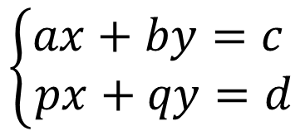
Systems of equations
Two or more equations, with an equal amount of variables.
Example:
$$\left\{\begin{aligned}ax+by=c \\ px+qy=d\end{aligned}\right.$$
Solution methods:
Graphical (not exact)
Substitution
Elimination (Gaussian elimination)

Slide 6
Segment 1: System of Two Equations

Slide 7
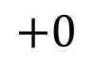
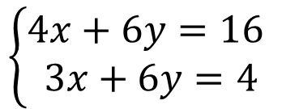
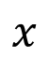
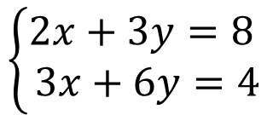
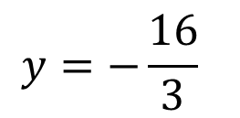
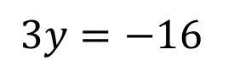
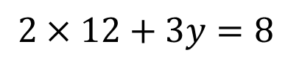
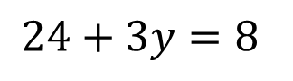
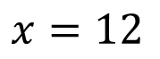
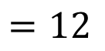
Algorithm & Example
$$\left\{\begin{aligned}2x+3y=8 \\ 3x+6y=4\end{aligned}\right.$$
Algorithm:
Multiply one of the equations with a constant, in such a way that one of the coefficients becomes equal to the coefficient in the other equation
Subtract both equations from each other
Solve for the remaining variable
Fill out the found variable in one of the original equations
Solve for the other unknown
X 2
$$\left\{\begin{aligned}4x+6y=16 \\ 3x+6y=4\end{aligned}\right.$$
$$x$$
$$+0$$
$$=12$$
$$x=12$$
$$2×12+3y=8$$
$$24+3y=8$$
$$3y=−16$$
$$y=−\frac{16}{3}$$

Slide 8
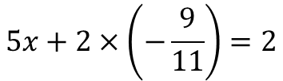
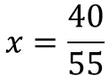
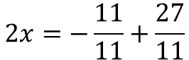
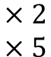
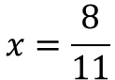
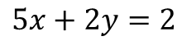
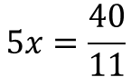
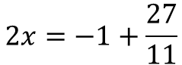
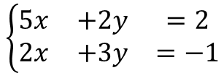
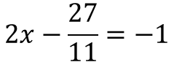
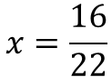
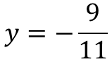
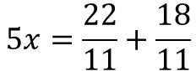
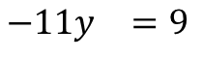
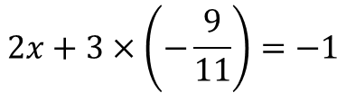
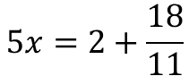
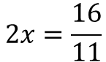
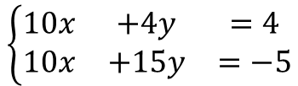
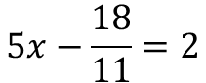
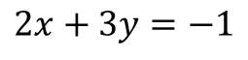

Example 2: First solve for y
$$\left\{\begin{matrix}5x & +2y & =2 \\ 2x & +3y & =−1\end{matrix}\right.$$
$$\begin{matrix}×2 \\ ×5\end{matrix}$$
$$5x+2y=2$$
$$2x+3y=−1$$
$$5x+2×\left(−\frac{9}{11}\right)=2$$
$$2x+3×\left(−\frac{9}{11}\right)=−1$$
$$\left\{\begin{matrix}10x & +4y & =4 \\ 10x & +15y & =−5\end{matrix}\right.$$
$$5x−\frac{18}{11}=2$$
$$2x−\frac{27}{11}=−1$$
$$\begin{matrix}−11y & =9\end{matrix}$$
$$5x=2+\frac{18}{11}$$
$$2x=−1+\frac{27}{11}$$
$$y=−\frac{9}{11}$$
$$5x=\frac{22}{11}+\frac{18}{11}$$
$$2x=−\frac{11}{11}+\frac{27}{11}$$
$$5x=\frac{40}{11}$$
$$2x=\frac{16}{11}$$
$$x=\frac{40}{55}$$
$$x=\frac{16}{22}$$
$$x=\frac{8}{11}$$
$$x=\frac{8}{11}$$

Slide 9


















Example 2: First solve for x
$$\left\{\begin{matrix}5x & +2y & =2 \\ 2x & +3y & =−1\end{matrix}\right.$$
$$\begin{matrix}×3 \\ ×2\end{matrix}$$
$$5x+2y=2$$
$$2x+3y=−1$$
$$5×\left(\frac{8}{11}\right)+2y=2$$
$$2×\left(\frac{8}{11}\right)+3y=−1$$
$$\left\{\begin{matrix}15x & +6y & =6 \\ 4x & +6y & =−2\end{matrix}\right.$$
$$\frac{40}{11}+2y=2$$
$$\frac{16}{11}+3y=−1$$
$$\begin{matrix}11x & & =8\end{matrix}$$
$$3y=−1−\frac{16}{11}$$
$$2y=2−\frac{40}{11}$$
$$x=\frac{8}{11}$$
$$2y=\frac{22}{11}−\frac{40}{11}$$
$$3y=−\frac{11}{11}−\frac{16}{11}$$
$$2y=−\frac{18}{11}$$
$$3y=−\frac{27}{11}$$
$$y=−\frac{18}{22}$$
$$y=−\frac{27}{33}$$
$$y=−\frac{9}{11}$$
$$x=−\frac{9}{11}$$

Slide 10








Practice 1
a
c
$$\left\{\begin{aligned}3x+5y=8 \\ −x+6y=5\end{aligned}\right.$$
$$\left\{\begin{aligned}2x−3y=1 \\ 3x−4y=0\end{aligned}\right.$$
$$x=1, y=1$$
$$x=−4, y=−3$$
b
d
$$\left\{\begin{aligned}7x−5y=1 \\ 4x−7y=13\end{aligned}\right.$$
$$\left\{\begin{aligned}3x−7y=2 \\ 3x−4y=−2\end{aligned}\right.$$
$$x=−2, y=−3$$
$$x=−\frac{22}{9}, y=−\frac{4}{3}$$

Slide 11































Answers
$$(×7)$$
$$\left\{\begin{aligned}3x+5y=8 \\ −x+6y=5\end{aligned}\right.$$
$$\left\{\begin{aligned}7x−5y=1 \\ 4x−7y=13\end{aligned}\right.$$
$$(×−3)$$
$$(×5)$$
$$3x+ 5y=8$$
$$49x−35y=7$$
$$3x−18y=−15$$
$$20x−35y=65$$
$$23y=23$$
$$29x=−58$$
$$\frac{23y}{23}=\frac{23}{23}$$
$$\frac{29x}{29}=\frac{−58}{29}$$
$$y=1$$
$$x=−2$$
$$3x+5y=8$$
$$7x−5y=1$$
$$3x+5×1=8$$
$$7×\left(−2\right)−5y=1$$
$$3x+5=8$$
$$−14−5y=1$$
$$3x+5−5=8−5$$
$$−14+14−5y=1+14$$
$$3x=3$$
$$−5y=15$$
$$\frac{3x}{3}=\frac{3}{3}$$
$$\frac{−5y}{−5}=\frac{15}{−5}$$
$$x=1$$
$$x=1, y=1$$
$$y=−3$$
$$x=−2, y=−3$$

Slide 12
























Answers
$$(×3)$$
$$\left\{\begin{aligned}3x−7y=2 \\ 3x−4y=−2\end{aligned}\right.$$
$$\left\{\begin{aligned}2x−3y=1 \\ 3x−4y=0\end{aligned}\right.$$
$$(×2)$$
$$6x−9y=3$$
$$−3y=4$$
$$6x−8y=0$$
$$y=−\frac{4}{3}$$
$$−y=3$$
$$y=−3$$
$$3x−7y=2$$
$$3x−7×−\frac{4}{3}=2$$
$$2x−3y=1$$
$$2x−3×−3=1$$
$$3x+\frac{28}{3}=2$$
$$2x+9=1$$
$$3x=\frac{6}{3}−\frac{28}{3}$$
$$2x=−8$$
$$\frac{2x}{2}=\frac{−8}{2}$$
$$3x=−\frac{22}{3}$$
$$x=−4$$
$$x=−\frac{22}{9}$$
$$x=−4, y=−3$$
$$x=−\frac{22}{9}, y=−\frac{4}{3}$$

Slide 13
Segment 2: System of Three Equations

Slide 14

Three equations with three unknowns
Example:
Algorithm:
Take two equations and work away one variable
Take one of the previous equations and the unused one, and work away the same variable
Take the two new equations with each two unknowns
Solve this system of two new equations
Fill out the solutions in one of the original equations
Solve for the remaining unknown variable.
$$\left\{\begin{aligned}2x+3y+2z=8 \\ 3x+5y+4z=4 \\ 4x−5y+6z=12\end{aligned}\right.$$

Slide 15






















Example
$$\left\{\begin{aligned}2x+3y+2z=8 \\ 3x+5y+4z=4 \\ 4x−5y+6z=12\end{aligned}\right.$$
Algorithm:
Take two equations and work away one variable
Take one of the previous equations and the unused one, and work away the same variable
Take the two new equations with each two unknowns
Solve this system of two new equations
Fill out the solutions in one of the original equations
Solve for the remaining unknown variable.
$$\left\{\begin{matrix}2x+3y+2z=8 \\ 3x+5y+4z=4\end{matrix}\right.$$
$$\left\{\begin{matrix}2x+3y+2z=8 \\ 4x−5y+6z=12\end{matrix}\right.$$
x 2
x 3
$$\left\{\begin{matrix}4x+6y+4z=16 \\ 3x+5y+4z=4\end{matrix}\right.$$
$$\left\{\begin{matrix}6x+9y+6z=24 \\ 4x−5y+6z=12\end{matrix}\right.$$
$$4x−3x+6y−5y=16−4$$
$$6x−4x+9y−−5y=24−12$$
$$x+y=12$$
$$2x+14y=12$$
$$\left\{\begin{matrix}x+y=12 \\ 2x+14y=12 \end{matrix}\right.$$
$$x+y=12$$
x 2
$$x+\left(−1\right)=12$$
$x=1$3
$$\left\{\begin{matrix}2x+2y=24 \\ 2x+14y=12 \end{matrix}\right.$$
$$2x+3y+2z=8$$
$$2y−14y=24−12$$
$$2×13+3×\left(−1\right)+2z=8$$
$$−12y=12$$
$$26−3+2z=8$$
$$23+2z=8$$
$$y=−1$$
$$z=−\frac{15}{2}$$

Slide 16






Practice 2
a
b
c
$$\left\{\begin{aligned}x−4y+z=−2 \\ −2x+3y−2z=−1 \\ −4x+y+z=−2\end{aligned}\right.$$
$$x=1, y=1,z=1$$
$$\left\{\begin{aligned}−2x−y+2z=5 \\ x+y−z=−3 \\ −3x+2y−6z=−5\end{aligned}\right.$$
$$x=−1, y=−1,z=1$$
$$\left\{\begin{aligned}x−3y+z=−1 \\ −2x+y=5 \\ 5y−2z=−3\end{aligned}\right.$$
$$multiple solutions$$

Slide 17





















Answers
$$\left\{\begin{aligned}x−4y+z=−2 \\ −2x+3y−2z=−1 \\ −4x+y+z=−2\end{aligned}\right.$$
1
2
$$x−4y+z=−2$$
$$x−4y+z=−2$$
$$(×−2)$$
$$−4x+y+z=−2$$
$$−2x+3y−2z=−1$$
$$5x−5y=0$$
$$−2x+8y−2z=4$$
$$−2x+3y−2z=−1$$
$$5y=5$$
$$y=1$$
3
$$5x−5y=0$$
4
$$x−4y+z=−2$$
$$5x−5×1=0$$
$$1−4×1+z=−2$$
$$5x−5=0$$
$$1−4+z=−2$$
$$5x=5$$
$$z=1$$
$$x=1$$
$$x=1, y=1,z=1$$

Slide 18





























Answers
1
2
$$\left\{\begin{aligned}−2x−y+2z=5 \\ x+y−z=−3 \\ −3x+2y−6z=−5\end{aligned}\right.$$
$$−2x−y+2z=5$$
$$(×−1)$$
$$−2x−y+2z=5$$
$$(×−2)$$
$$x+y−z=−3$$
$$−3x+2y−6z=−5$$
$$2x+y−2z=−5$$
$$4x+2y−4z=−10$$
$$x+y−z=−3$$
$$−3x+2y−6z=−5$$
$$x−z=−2$$
$$7x+2z=−5$$
3
$$x−z=−2$$
$$(×−2)$$
4
$$x−z=−2$$
$$7x+2z=−5$$
$$−1−z=−2$$
$$−2x+2z=4$$
$$−z=−1$$
$$7x+2z=−5$$
$$z=1$$
$$−9x=9$$
5
$$x+y−z=−3$$
$$x=−1$$
$$−1+y−1=−3$$
$$y−2=−3$$
$$x=−1, y=−1,z=1$$
$$y=−1$$

Slide 19














Answers
1
2
$$\left\{\begin{aligned}x−3y+z=−1 \\ −2x+y=5 \\ 5y−2z=−3\end{aligned}\right.$$
$$x−3y+z=−1$$
$$(×−2)$$
$$5y−2z=−3$$
$$−2x+y =5$$
$$5y−2z=−3$$
$$0=0$$
$$−2x+6y−2z=2$$
$$−2x+y =5$$
$$5y−2z=−3$$
3
$$5y−2z=−3$$
$$5y=−3+2z$$
$$y=−\frac{3}{5}+\frac{2}{5}z$$
$$multiple solutions$$

Slide 20
Closure
Overview & H☺mew☹rk

Slide 21
Overview so far…
Power rules
Fraction rules
Notation rules
P1 | $$a^{p}×a^{q} =a^{p+q}$$
F1 | $$\frac{a}{b}=\frac{a×c}{b×c}=\frac{a/c}{b/c}$$
F5 | $$\frac{a}{b}×\frac{c}{d}=\frac{a×c}{b×d}$$
N1 | $$\frac{a}{b}=a/b=a:b$$
P2 | $$a^{p}:a^{q}=a^{p−q}$$
F2 | $$\frac{a}{b}+\frac{c}{b}=\frac{a+c}{b}$$
F6 | $${\frac{a}{b}}/c=\frac{a}{b×c}$$
N2 | $$a^{p}=a×a×…×a \\ (p \text{times})$$
P3 | $${\left(a^{p}\right)}^{q} =a^{p×q}$$
P4 | $${\left(a×b\right)}^{p}=a^{p}×b^{p}$$
F3 | $$\frac{a}{b}−\frac{c}{b}=\frac{a−c}{b}$$
F7 | $${\frac{a}{b}}/{\frac{c}{d}}=\frac{a×d}{b×c}$$
N3 | $$a^{1}=a$$
P5 | $${\left(\frac{a}{b}\right)}^{p}=\frac{a^{p}}{b^{p}}$$
N4 | $$a×b=a∙b=ab$$
F4 | $$\frac{a}{b}×c=\frac{a×c}{b}$$
F8 | $$\frac{a}{b}+\frac{c}{d}=\frac{ad+cb}{bd}$$
N5 | $$\sqrt{a}=\sqrt[2]{a}$$
P6 | $$a^{−p}=\frac{1}{a^{p}}$$
Basic rules
Root rules
Brackets rules
B1 | $$\frac{a}{1}=a$$
R1 | $$\sqrt{a^{2}}=a$$
R1 | $$\sqrt[n]{a^{n}}=a$$
Br1 | $$a\left(b+c\right)=ab+ac$$
R2 | $${\left(\sqrt[n]{a}\right)}^{n}=a$$
B2 | $$\frac{a}{a}=1$$
R2 | $${\left(\sqrt{a}\right)}^{2}=a$$
Br2 | $$\left(a+b\right)\left(c+d\right)=ac+ad+bc+bd$$
R3 | $$\sqrt[n]{a}×\sqrt[n]{b}=\sqrt[n]{a×b}$$
R3 | $$\sqrt{a}×\sqrt{b}=\sqrt{a×b}$$
Br3 | $${\left(a+b\right)}^{2}=a^{2}+2ab+b^{2}$$
B3 | $$a×1=a$$
R4 | $$\frac{a}{\sqrt{b}}=\frac{a}{b}\sqrt{b}$$
Br4 | $${\left(a−b\right)}^{2}=a^{2}−2ab+b^{2}$$
B4 | $$a×b=b×a$$
B5 | $$a+b=b+a$$
R5 | $$\sqrt{\frac{a}{b}}=\frac{1}{b}\sqrt{a×b}$$
Br5 | $$\left(a+b\right)\left(a−b\right)=a^{2}−b^{2}$$

Slide 22
Algorithms, Game Rules & Formulas
Algorithms
A1: Prime factorization
A2: Divisors
A3: GCD
A4: LCM
A5: Simplify fraction
A6: LCD
A7: Simplify square root
A8: Common Denominator
A9: Simplify fraction with Letters
A10: Completing the square
A11: System of equations
Game Rules
G1: Rules for equations
G2: Rules for inequalities
Formulas
FO1: abc-Formula

Slide 23

H☺me W☹rk
Chapter 11: pg. 84-87
Selected Exercises: pg. 84: 11.1(a,c,e) 11.2(a,c,e) 11.3(a,c,e) 11.4(a,c,e) pg. 86: 11.5(a,c,e) 11.6(a,c,e) 11.7(a,b) 11.8(a,b)

